Slide 1
The Best IaC Tool In The World! (in my opinion)
Ryan Bartram | Jan Oehen

Slide 2
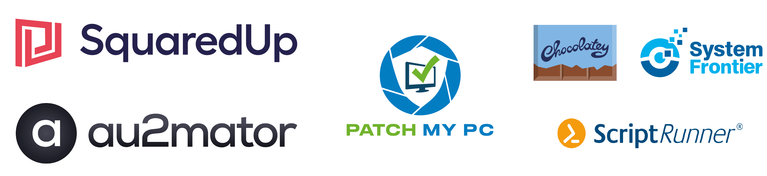
Many thanks to our sponsors:

Slide 3


Ryan Bartram
Both Azure Cloud Engineers
Both Automation/pwsh Advocates
Both work at Worxspace
In other words
Same same, but different…
But still same
Jan Oehen

Slide 4


Are you already onboard?
Newbie
No experience of IaC
Not yet scarred by failure
Perfect time to start
Seasoned Vet
Seen many builds fail
Likely loyal to the tool and very opinionated
Perfect time to switch
Notes:
Why IaC?
Idempotency, repeatability
DRY
CI/CD -> People don’t need permissions to systems

Slide 5
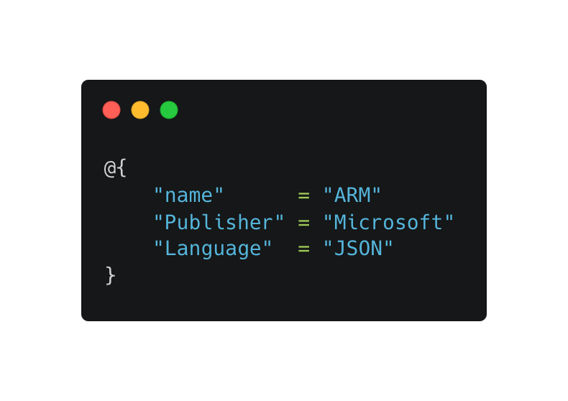
Challenger 1
SHOW-TOOL
Notes:
- Native Microsoft

Slide 6
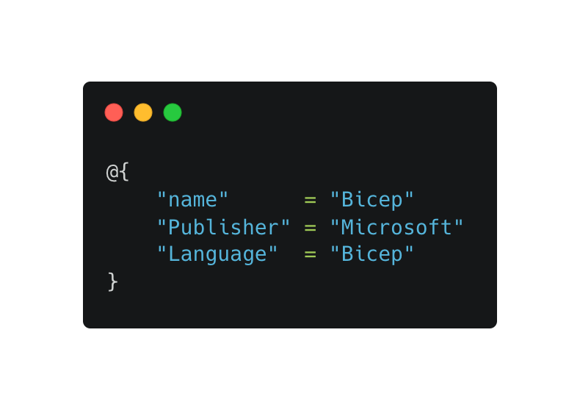
Challenger 2
SHOW-TOOL
Notes:
But:
- JSON sucks
Bicep -> Nicer language, still native, shorter

Slide 7
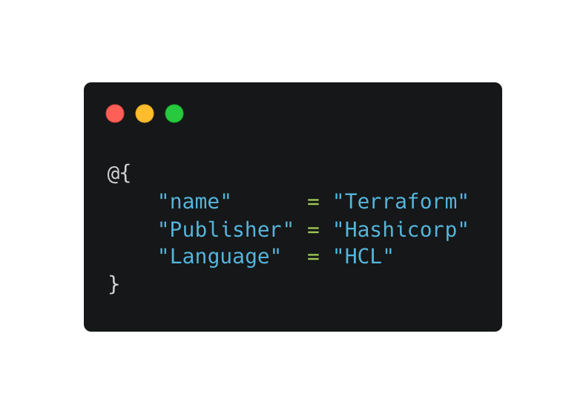
Challenger 3
SHOW-TOOL
Notes:
But:
Just generates ARM
Scoping sucks
Terraform -> Less fuss, not JSON, Multi-Platform

Slide 8
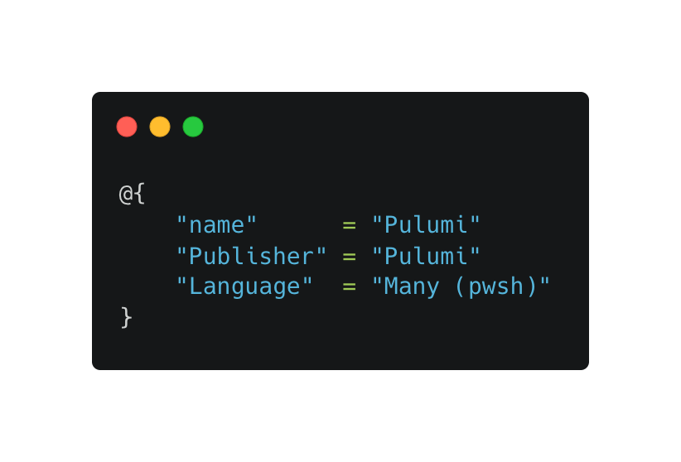
Challenger 4
SHOW-TOOL
Notes:
But:
Syntax often still sucks (loops)
Can’t satisfy Azure Policy sometimes (public endpoints on creation)
Delay in support for new stuff (although marginal)
Pulumi -> Can work with many 1st class programming languages (pwsh)
Directly talks to the API

Slide 9
Demos
We love Demos!
Notes:
Pulumi YAML saved our ass
Pwsh generates YAML
Giant Schema file
Starter file with RG and intellisense
Pulumi.ps1
Loop
Reference
Modularization
Complete with function call
- Pester / PSScriptanalyzer rules to be developed
- PSCafNaming

Slide 10


Links and Q&A
https://github.com/worxspace/PSPulumi
https://github.com/worxspace/pspulumistarter

